Slide 1
Software Testing- Basics & Concepts
2025
Poornima

Slide 2
What is Software?
Software is a set of instructions, data, or programs used to operate computers and other electronic devices, enabling them to perform specific tasks

Slide 3
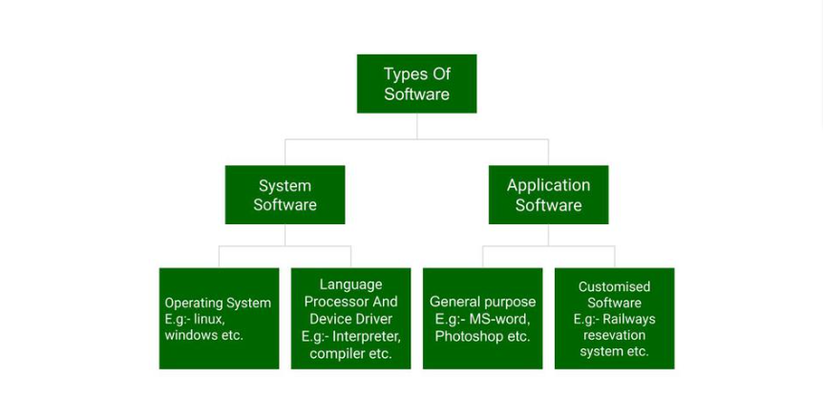
Types of Software

Slide 4
What is Software Testing?
Software testing is a systematic process of evaluating and verifying a software application or system to ensure it meets its specified requirements and functions as intended.
The primary goals of software testing include:
Identifying
Identifying Defects and Bugs
Ensuring
Ensuring Quality
Validating
Validating Requirements
Improving
Improving Performance and User Experience

Slide 5
What is Software Testing?
Software Testing is a process of verifying and validating whether the Software Product or Application is working as expected or not. The complete testing includes identifying errors and bugs that cause future problems for the performance of an application.

Slide 6
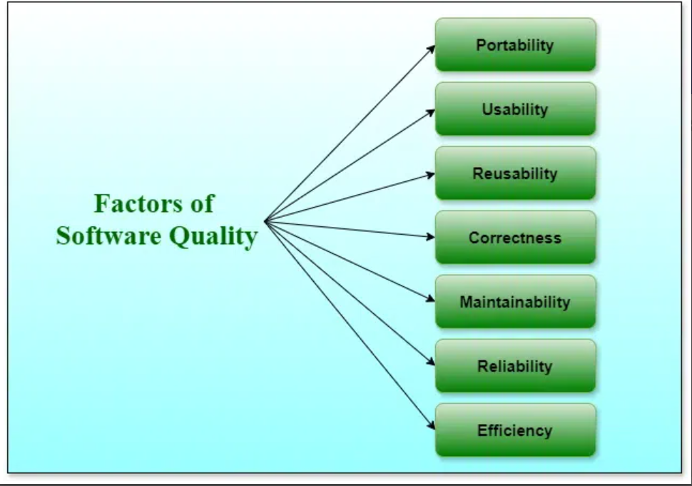
Software Quality
Software quality shows how good and reliable a product is.

Slide 7
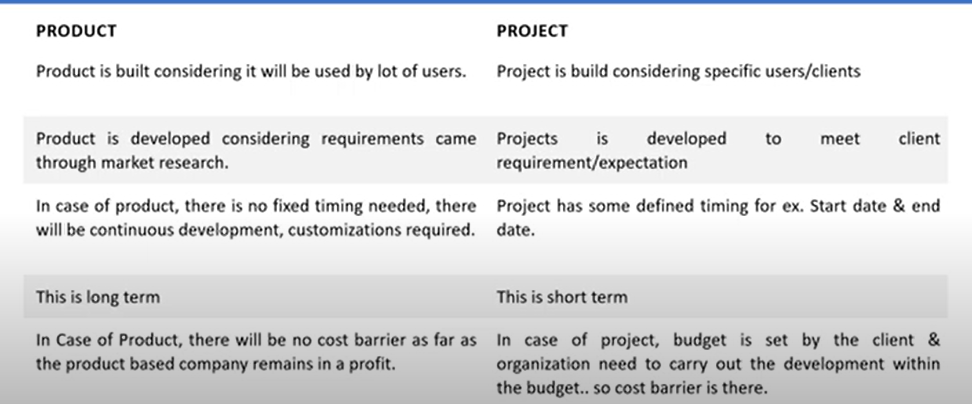
Project Vs Product

Slide 8
Why do we need Testing?
To identify defects
To reduce flaws in the component or system
Increase the overall quality of the system

Slide 9
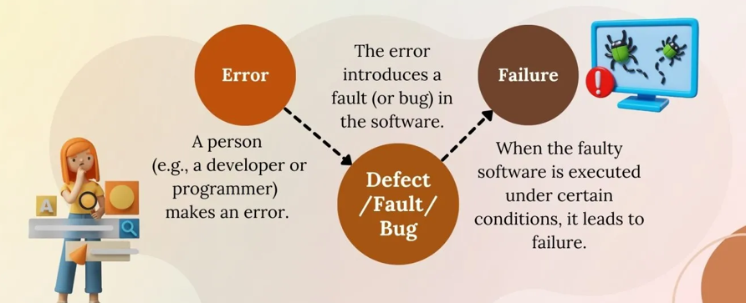
Error, Bug, Failure

Slide 10
Software Testing CONCEPTS

Slide 11
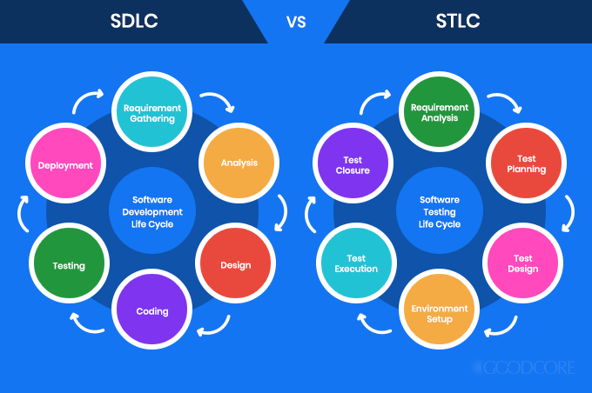
SDLC
Software Development Life Cycle (SDLC) is a structured process that is used to design, develop, and test high-quality software.
The goal of the SDLC life cycle model is to deliver high-quality, maintainable software that meets the user's requirements.

Slide 12
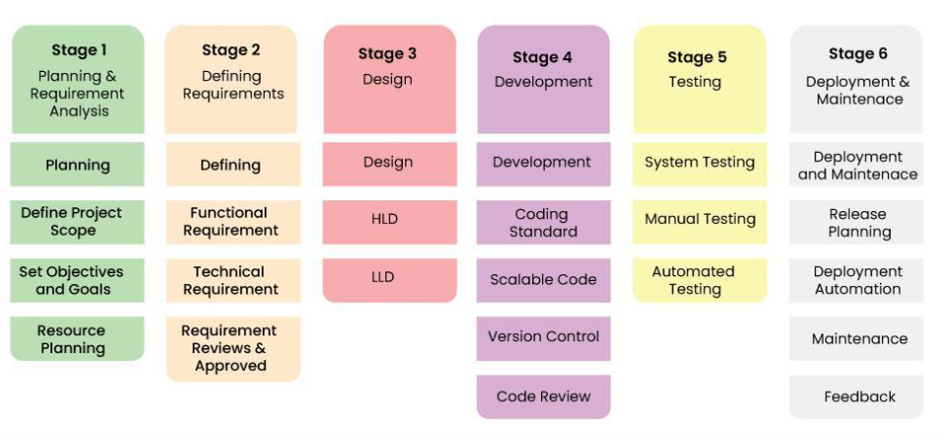
Stages of SDLC

Slide 13
Software Development Life Cycle Models
Waterfall Model
Spiral Model
V-Model
Agile Model
Incremental Model
RAD Model

Slide 14
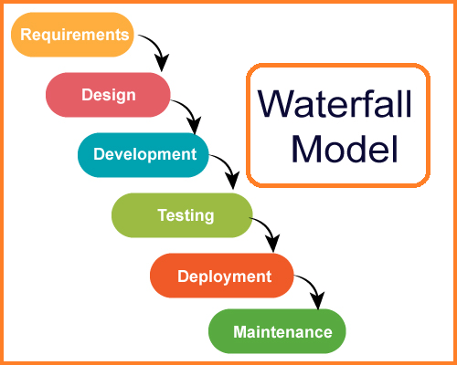
Waterfall Model
Features of Waterfall Model
Linear & Sequential Approach
Document-Driven
Rigorous Planning
Best suited for small, well‑defined, and stable projects where requirements do not change frequently.

Slide 15
Waterfall Model
✅ Advantages
Simple and easy to understand
Clear structure and documentation
Works well for small projects with fixed requirements
Easy to manage due to its sequential nature
❌ Disadvantages
Not flexible; changes are difficult once a phase is completed
Testing happens late, increasing risk
Not suitable for complex or evolving projects
Customer involvement is minimal after the requirements phase

Slide 16
Spiral Model
Spiral model that provides a systematic and iterative approach to software development.
The Spiral Model is a combination of the waterfall model and the iterative model. It provides support for Risk Handling.
The Spiral Model was first proposed by Barry Boehm.
In its diagrammatic representation, looks like a spiral with many loops. The exact number of loops of the spiral is unknown and can vary from project to project. Each loop of the spiral is called a phase of the software development process

Slide 17
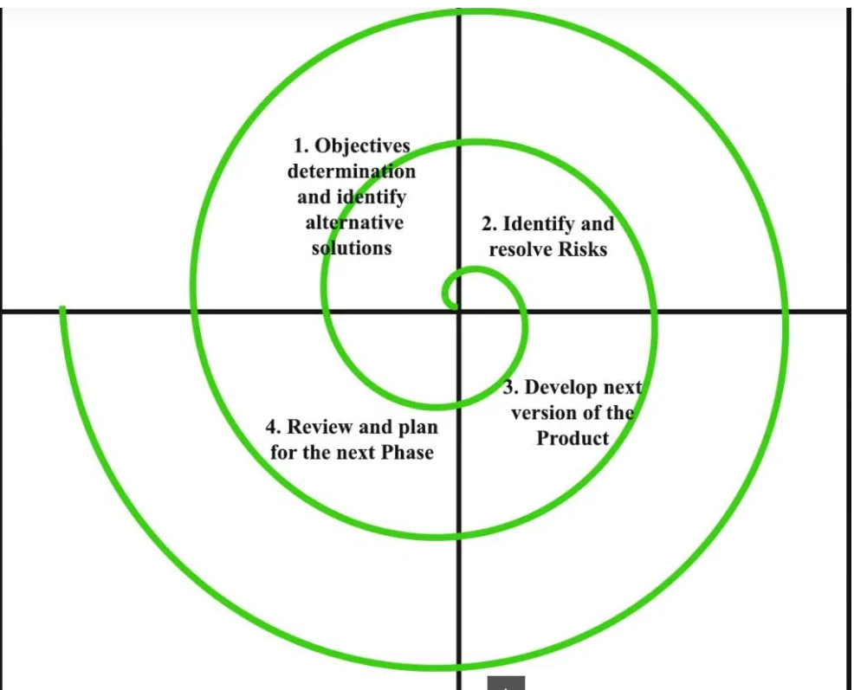
Spiral Model

Slide 18
Spiral Model
Advantages of the Spiral Model
Risk Handling
Good for large, complex and high risk projects
Flexibility in Requirements
Customer Satisfaction
Iterative and Incremental Approach
Emphasis on Risk Management
Improved Communication
Improved Quality

Slide 19
Spiral Model
Disadvantages of the Spiral Model
Complex
Expensive
Too much dependability on Risk Analysis
Difficulty in time management
Time-Consuming

Slide 20
V- Model
The V-model in software testing is a SDLC (Software Development Life Cycle) model that emphasizes verification and validation throughout the development process.
It's an extension of the waterfall model, where each phase of development has a corresponding testing phase.
This model aims to identify defects early and reduce the risk of costly fixes later in the project.

Slide 21
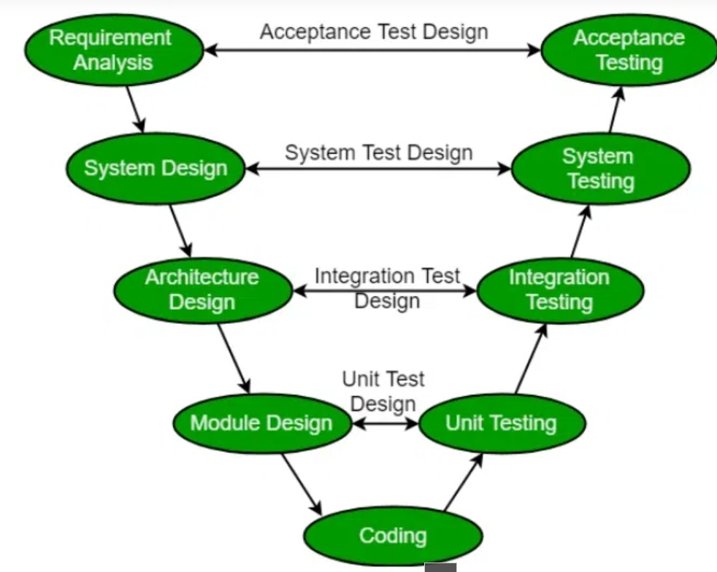
V- Model
Phases of V-Model

Slide 22
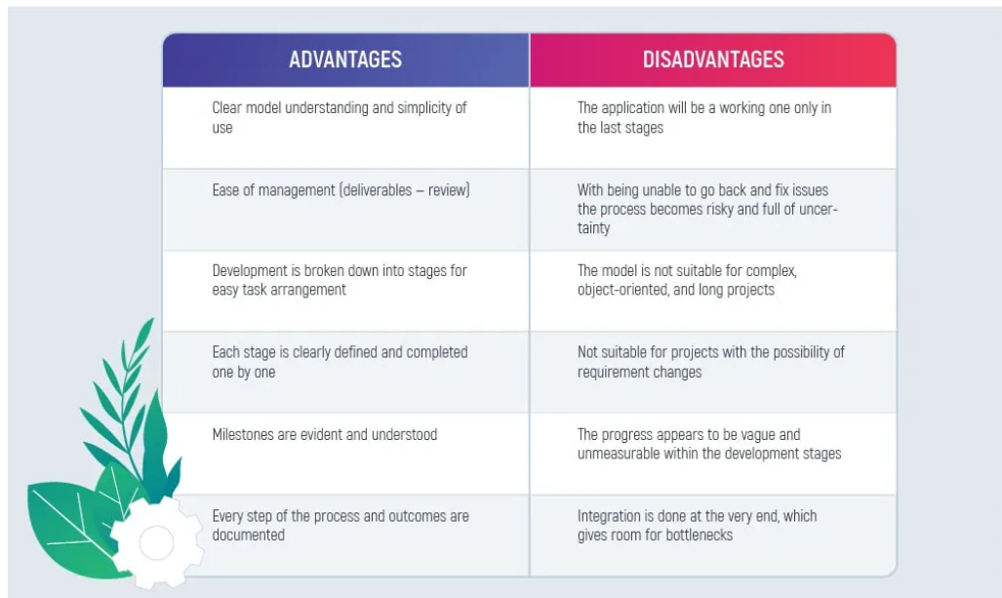
V- Model

Slide 23
Verification, Validation
Verification is the process of checking that software achieves its goal without any bugs. It is the process to ensure whether the product that is developed is right or not. It verifies whether the developed product fulfills the requirements that we have. Verification is static testing. Verification means Are we building the product right?
Validation is the process of checking whether the Software Product is up to the mark or in other words product has high-level requirements. It is the process of checking the validation of the product i.e. it checks what we are developing is the right product. It is validation of the actual and expected products. Validation is dynamic testing. Validation means Are we building the right product?

Slide 24
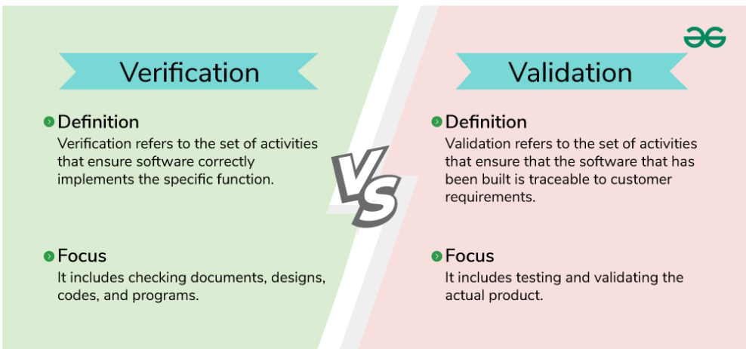
Verification, Validation

Slide 25
Comparison of Waterfall, V-Model & Spiral Model
Aspect | Waterfall Model | V‑Model | Spiral Model
Process Type | Linear & sequential | Linear with parallel testing | Iterative & risk‑driven
Focus | Completing each phase once | Verification + Validation | Risk analysis & prototyping
Flexibility | Very low | Low | Very high
Customer Involvement | Low (end only) | Low to medium | High (each iteration)
Risk Handling | Weak | Moderate | Strong (core feature)
Testing Approach | Testing after development | Testing planned for each phase | Testing in every iteration
Cost & Time | Low for small projects | Moderate | High (due to repeated cycles)
Best For | Small, simple, stable projects | Medium projects with clear requirements | Large, complex, high‑risk projects
Documentation | Heavy | Heavy | Moderate to heavy
Output | Single final product | Single final product with quality focus | Multiple prototypes + final product
Requirement Stability | Must be stable | Must be stable | Can evolve

